Slide 1



{Kendo UI for React}

Slide 2

{Progress Virtual Classroom}

Slide 3
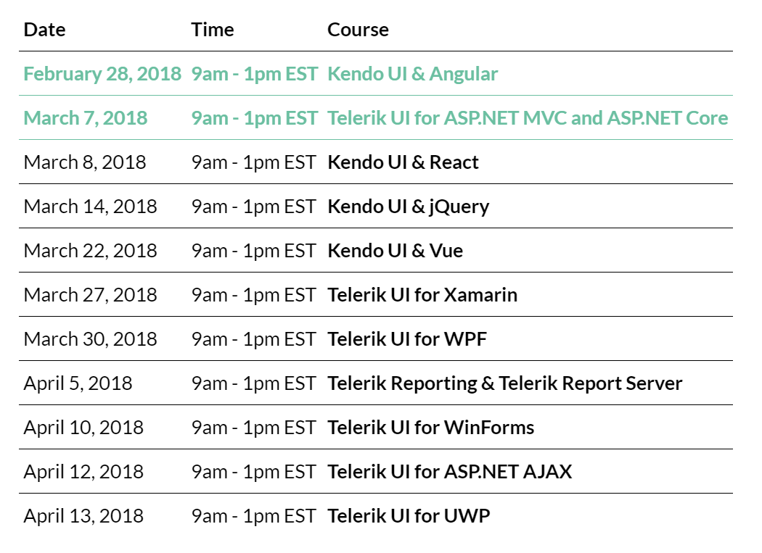

Slide 4

Milan Nankov
Co-Founder New Venture Software
@milannankov
/milannankov
milan@newventuresoftware.com

Slide 6
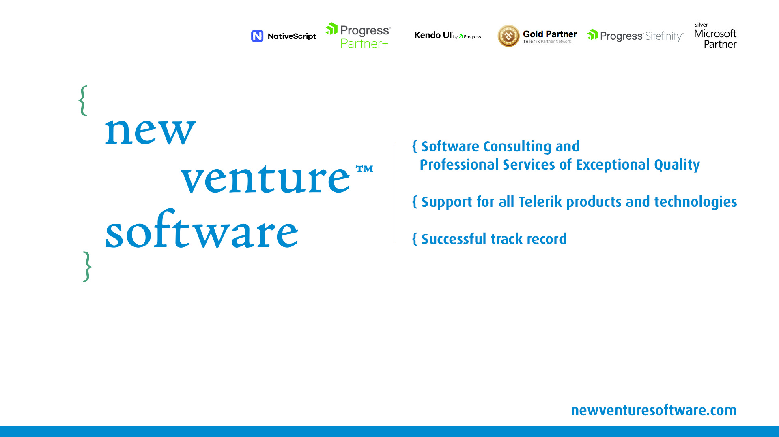

Slide 7
{Agenda}
Getting started with React
Kendo UI for React
Let’s build an app

Slide 8
{Getting started with React}
Prerequisites
ES6 Refresher
React Foundations

Slide 9
{Prerequisites}
Node.js (>= 6 recommended) https://nodejs.org/en/download/current/
IDE/editor of choice Visual Studio Code, Sublime Text etc.
Browser Chrome, Firefox, Edge, Safari, etc.
create-react-app https://github.com/facebook/create-react-app
React Developer Tools https://github.com/facebook/react-devtools
Slides and demos https://github.com/newventuresoftware/kendo-ui-for-react

Slide 10
{My setup}
Chrome
React Developer Tools
Visual Studio Code
Simple React Snippets
TypeScript React Snippets
vscode-icons

Slide 11
{ES6 Refresher}
const & let arrow functions spread
classes modules

Slide 12

{Let}
The let statement declares a block scope local variable.
let x = 1;
if (x === 1) {
let x = 2;
console.log(x);
// output: 2
}
console.log(x);
// output: 1
var x = 1;
if (x === 1) {
var x = 2;
console.log(x);
// output: 2
}
console.log(x);
// output: 2

Slide 13
{Const}
The const statement declares a block scope, read-only variable.
const x = 1;
x = 2;
// TypeError: Assignment to constant variable.

Slide 14
{Arrow functions}
Arrow functions allow us to write shorter functions.
const numbers = [5, 6, 7, 8, 9];
const sum1 = numbers.reduce(function (a, b) {
return a + b;
});
const sum2 = numbers.reduce((a, b) => { a + b });
const sum3 = numbers.reduce((a, b) => a + b );

Slide 15
{Arrow functions}
Arrow functions use the this value of the enclosing execution context.
function Something() {
this.value = 0;
// required for capturing this
var that = this;
setInterval(function() {
that.value++;
}, 1000);
}
var s = new Something();
function Something() {
this.value = 0;
setInterval(() => {
this.value++;
}, 1000);
}
var s = new Something();

Slide 16
{… Spread}
Allows an iterable to be expanded in places where zero or more arguments are expected
const cars = ["Honda", "Mazda", "Tesla"];
const countries = ["USA", "Italy", "Belgium"];
const combined = [
...cars,
...countries
]
// combined = ["Honda", "Mazda", "Tesla", "USA", "Italy", "Belgium"]

Slide 17
{Classes}
Syntactical sugar over JavaScript's existing prototype-based inheritance.
function Animal(type) {
this.type = type;
}
Animal.prototype.makeSound = function () {
// make sound
}
var animal = new Animal("cow");
class Animal {
constructor(type) {
this.type = type;
}
makeSound() {
// make sound
}
}
var animal = new Animal("cow");

Slide 18
{Modules}
The problem – no explicit dependencies, namespace hell, questionable reusability
// dateManipulation.js
function getDaysCurrentMonth() {
const days = 28;
return days;
}
// salary.js
function getSalary() {
const daysInMonth = getDaysCurrentMonth();
return daysInMonth * 1000;
}
<!DOCTYPE html>
<html>
<head>
<title>Salary APP</title>
</head>
<body>
<script src="./dateManipulation.js"></script>
<script src="./salary.js"></script>
</body>
</html>

Slide 19
{Modules}
Modules allow for creating and using self-contained pieces of code.
// dateManipulation.js
export function getDaysCurrentMonth() {
const days = 28;
return days;
}
// salary.js
import { getDaysCurrentMonth } from './dateManipulation';
function getSalary() {
const daysInMonth = getDaysCurrentMonth();
return daysInMonth * 1000;
}

Slide 20
{React Foundations}
Development Environment
JSX
Virtual DOM
Components
State, Props, and Lifecycle

Slide 21

{What is React?}
React is a declarative, efficient, and flexible JavaScript library for building user interfaces.
Lightweight
Virtual DOM
Top-down data flow
Easy to build prototypes

Slide 22

{Infrastructure hell}
Webpack + Babel + React + Redux + Routing

Slide 23
{create-react-app}
An easy way to get started with React
https://github.com/facebook/create-react-app
npm install –g create-react-app
create-react-app my-app
cd ./my-app
npm start

Slide 24
{Source & Slides}
Resources for this training
https://github.com/newventuresoftware/kendo-ui-for-react
git clone https://github.com/newventuresoftware/kendo-ui-for-react
cd kendo-ui-for-react
cd react
npm install
npm start

Slide 25
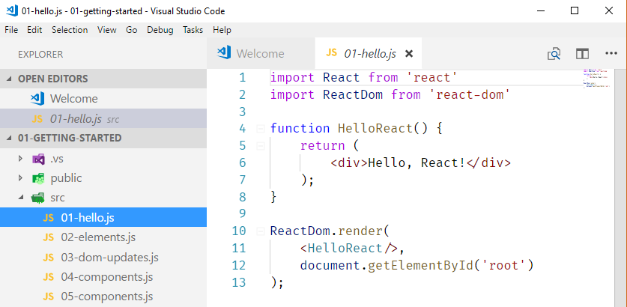
{Demo}
Hello React

Slide 26
{JSX}
Keeps code + html in the sample place
https://reactjs.org/docs/introducing-jsx.html
function HelloReact() {
return (
<div>Hello, React!</div>
);
}

Slide 27
{Babel}
JavaScript compiler that produces browser-compatible JavaScript
https://babeljs.io/repl/
[1, 2, 3].map(n => n + 1);
// converted to
[1, 2, 3].map(function (n) {
return n + 1;
});

Slide 28
{Demo}
React Elements

Slide 29
{React Elements}
The smallest building blocks of React apps
https://reactjs.org/docs/rendering-elements.html
Describes what should be displayed on the screen
Very lightweight
JSX gets converted to React.createElement
Building block of the Virtual DOM

Slide 30
{Virtual DOM}
A tree data structure composed of react elements.
function HelloReact() {
return React.createElement(
'div',
null,
[React.createElement(
'span',
null,
'Hello, React!'
),
React.createElement(
'span',
null,
'Hello, React 2!'
)]
);
}
HelloReact
div
span
span

Slide 31
{Rendering}
HelloReact
<div>
div
<span>
<span>
span
span

Slide 32
{Demo}
Virtual DOM in Action

Slide 33
{Reconciliation}
What happens when React components are updated.
App
App
div
div
button
CurrentTime
button
CurrentTime
div
div
"Current time is: "
"Current time is: "
"1:21:41 PM"
"1:22:53 PM"

Slide 34
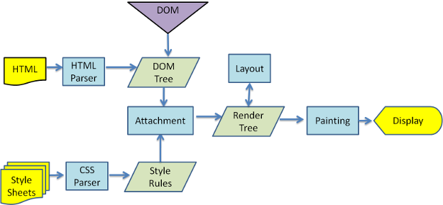
{Why the DOM is slow}

Slide 35
{React Fiber}
React's core algorithm. https://github.com/acdlite/react-fiber-architecture

Slide 36
{Demo}
Components, Properties, and State

Slide 37
{Components}
Components let you split the UI into independent, reusable pieces, and think about each piece in isolation.
Properties
Read only
Passed from parent to child
State
Keeps track of data that can change
Components control their own state

Slide 38
{State}
https://reactjs.org/docs/state-and-lifecycle.html
Do Not Modify State Directly
State Updates May Be Asynchronous
State Updates are Merged
The Data Flows Down

Slide 39
{What to put in state?}
The million dollar question.
Values that affect the visual rendering
State data should be referenced in render()

Slide 40
{Component Lifecycle}
Mounting
Updating
Unmounting
componentWillMount
componentWillReceiveProps
componenetWillUnmount
render
componentWillUpdate
componentDidMount
render
componentDidUpdate

Slide 41
{Kendo UI for React}

Slide 42
{Short Break}
Back in 10 minutes

Slide 43
{Kendo UI for React}
What’s New
Component comparison
Getting started

Slide 44
{What’s new?}
2018 R1 - Kendo UI for React Official Release
Animations
Buttons
DateInputs
DropDowns
Grid
Inputs
Internationalization
Layout
Popup

Slide 45

{What’s in the box?}
React components
React wrappers
Common features
Premium support services
Impressive documentation

Slide 46
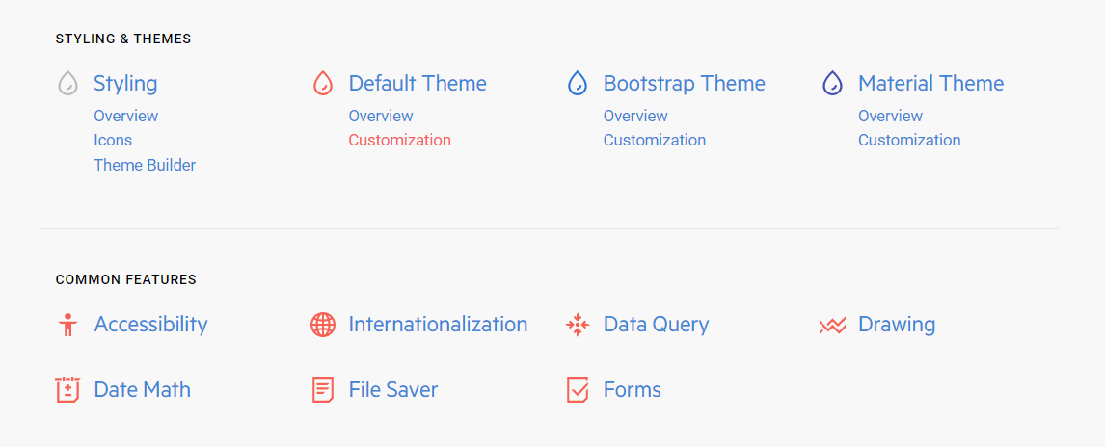
{Common Features}

Slide 47
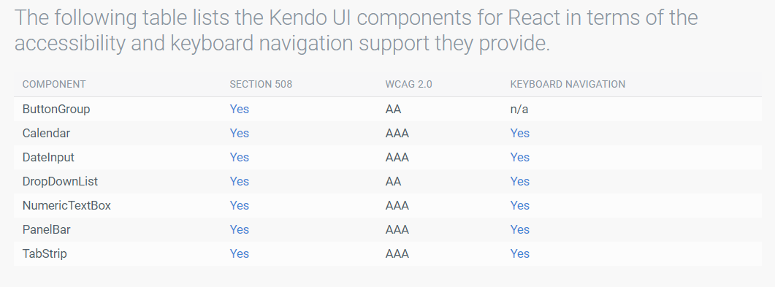
{Accessibility
Section 508, WCAG 2.0, WAI-ARIA, and Keyboard Navigation

Slide 48
{Components vs. Wrappers}
The big picture.
https://www.telerik.com/kendo-react-ui/components/
Why have both?
Difference in number of components
Difference in features of components
Both can work together

Slide 49
{Components vs. Wrappers}
How to choose?
Check is native component/feature exists
If yes, choose native component
If no, use wrapper component

Slide 50
{Demo}
Components in Action

Slide 51
{Using components}
Install component and dependencies (check docs)
Install Kendo theme
Import theme CSS
Import component
npm install --save @progress/kendo-react-dropdowns
npm install --save @progress/kendo-theme-default
import '@progress/kendo-theme-default/dist/all.css';
import { DropDownList } from '@progress/kendo-react-dropdowns';

Slide 52
{Using wrappers}
Install component and dependencies (check docs)
Install Kendo UI for jQuery
Install Kendo theme
Import theme CSS
Import component
Import Kendo UI for jQuery
npm install --save @progress/kendo-charts-react-wrapper
npm install --save @progress/kendo-theme-default
npm install –-save @progress/kendo-ui
import '@progress/kendo-theme-default/dist/all.css’;
import '@progress/kendo-theme-default/dist/all.css’;
import '@progress/kendo-ui’;
import { Chart } from '@progress/kendo-charts-react-wrapper';

Slide 53
{Roadmap}
What's next for Kendo UI for React?
https://www.telerik.com/kendo-react-ui/roadmap/

Slide 54

{Demo}
Let’s Build an App

Slide 55
{Requirements}
Build a time tracking app with the following features:
Log hours by starting/stopping a timer
Assigns tasks to projects
View dashboard with statistics
Delete tasks

Slide 56
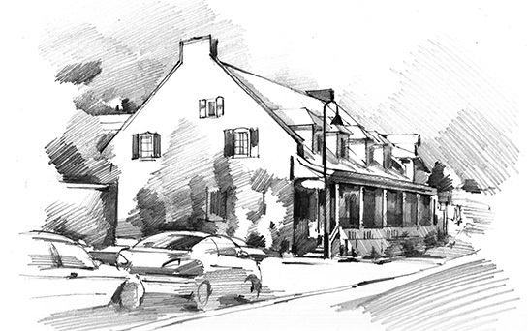
{Sketching}
It all begins with a sketch…

Slide 57
{Screens - Tracking}
Current Task Timer
Navigation Bar
Task name
Project selector
Timer
Navigation Item
Navigation Item
Task History Grid

Slide 58
{Screens - Dashboard}
Navigation Bar
Project Hours Chart
Navigation Item
Navigation Item

Slide 59
{React Router}
https://reacttraining.com/react-router/

Slide 60
{Resources}
Pure React - https://daveceddia.com/pure-react/

Slide 61
{Thank you!}
subtitle

Slide 62
{This is a title}
Some text

Slide 63
{This is a title}
This is text

Slide 64
{This is a section title}
subtitle

Slide 65
{This is a section title}
subtitle

